Slide 1

Exodus 1

Slide 2
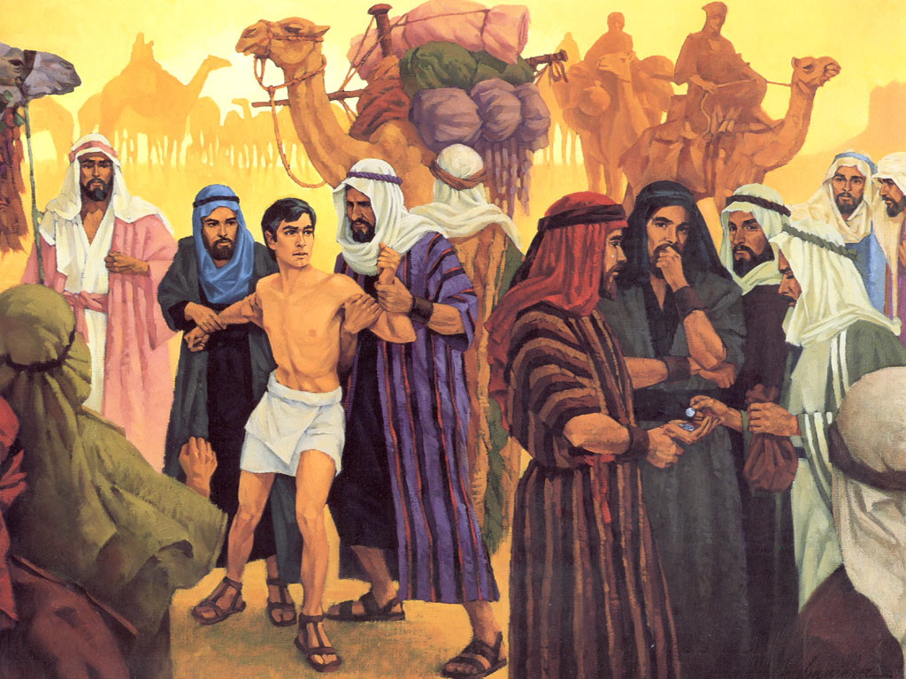

Slide 3
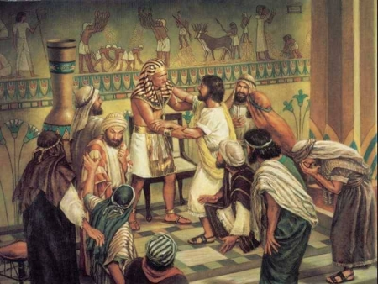

Slide 4
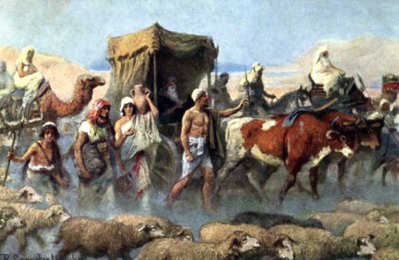

Slide 5
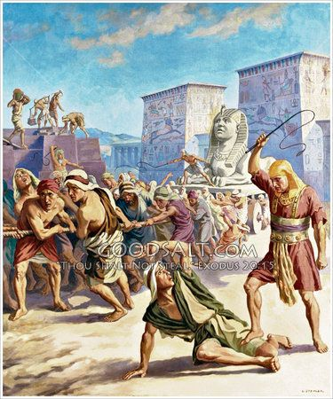

Slide 6
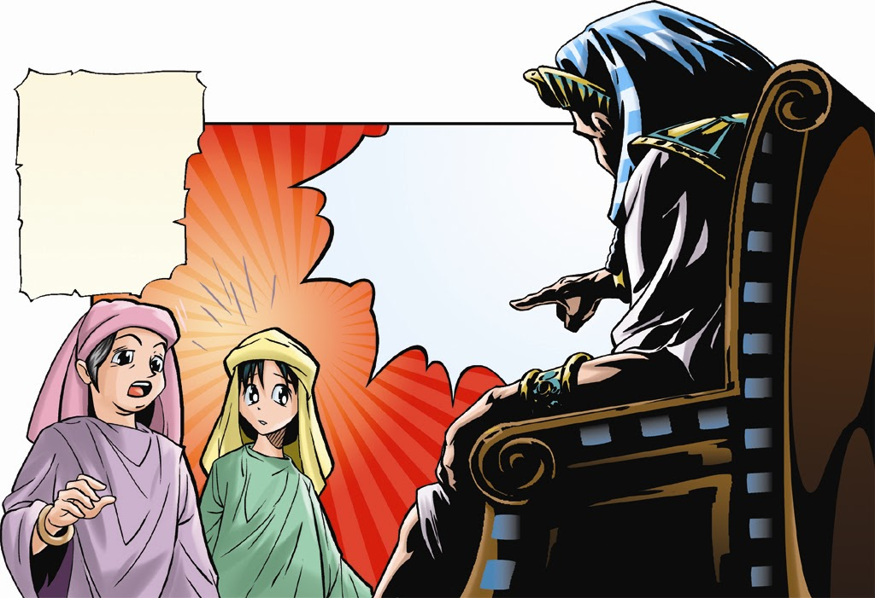

Slide 7
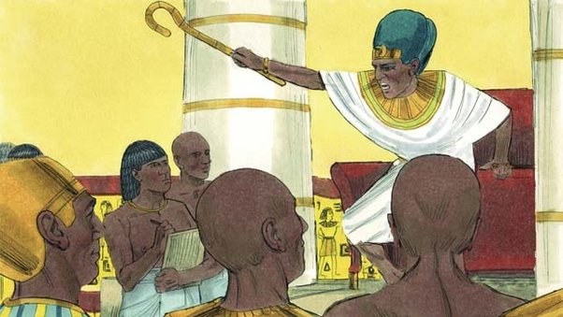

Slide 8
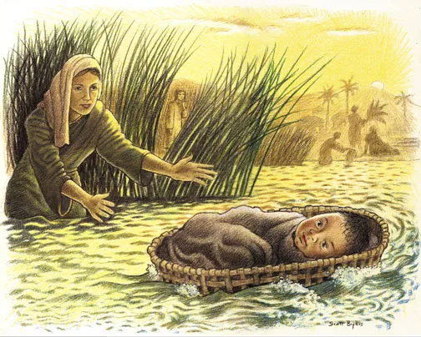

Slide 9
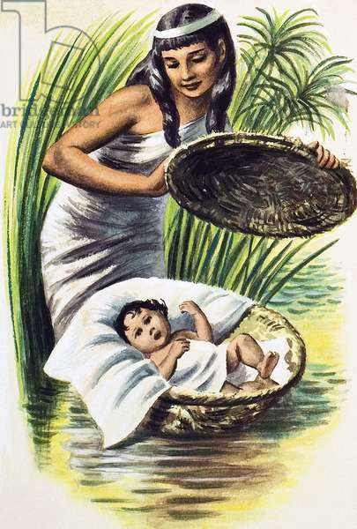

Slide 10
What stopped Pharaoh’s plan?
___________
___________
___________

Slide 11
Who stopped Pharaoh’s plan?

Slide 12
God stopped Pharaoh’s plan!

Slide 13
Who can stop God’s plans?

Slide 14
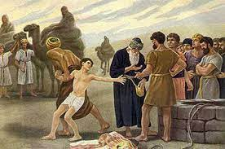

Slide 15
Joseph…the Unexpected Saviour
Moses…the Hidden Saviour

